Slide 1
FAKE NEWS PROJECT
SUBMITTED BY,
Purva Sonsare

Slide 2
INTRODUCTION
Fake news is defined as a made-up story with an intention to deceive or to mislead. The rate of production of fake news has increased exponentially. In the past news obtained from newspaper, radio or TV were considered as the best and authentic source of information about the real world and ongoing situations but now everything has changed. In the run of popularity and ill mind set the media houses and social media are spreading fake news. It’s becoming harder and harder to say whether a piece of news is real or fabricated.
The effect of fake news can be seen everywhere. The fake news leads to communal disturbance, character assassination, mental trauma, sometimes it is used as a weapon to achieve some illicit plans etc. these are like wild fire which spread too quickly and difficult to control. Which creates difficulty in differentiating between fake news and authentic news.
Technologies such as Artificial Intelligence (AI) and Natural Language Processing (NLP) tools offer great promise for researchers to build systems which could automatically detect fake news. However, detecting fake news is a challenging task to accomplish as it requires models to summarize the news and compare it to the actual news in order to classify it as fake. Moreover, the task of comparing proposed news with the original news itself is a daunting task as it's highly subjective and opinionated.
The goal is to build a prototype to classify the news as fake or not fakes in order to bring awareness and reduce unwanted chaos.

Slide 3

Problem Statement
Fake news has become one of the biggest problems of our age. It has serious impact on our online as well as offline discourse. One can even go as far as saying that, to date, fake news poses a clear and present danger to western democracy and stability of the society.
The authenticity of Information has become a longstanding issue affecting businesses and society, both for printed and digital media. On social networks, the reach and effects of information spread occur at such a fast pace and so amplified that distorted, inaccurate, or false information acquires a tremendous potential to cause real-world impacts, within minutes, for millions of users. Recently, several public concerns about this problem and some approaches to mitigate the problem were expressed.

Slide 4
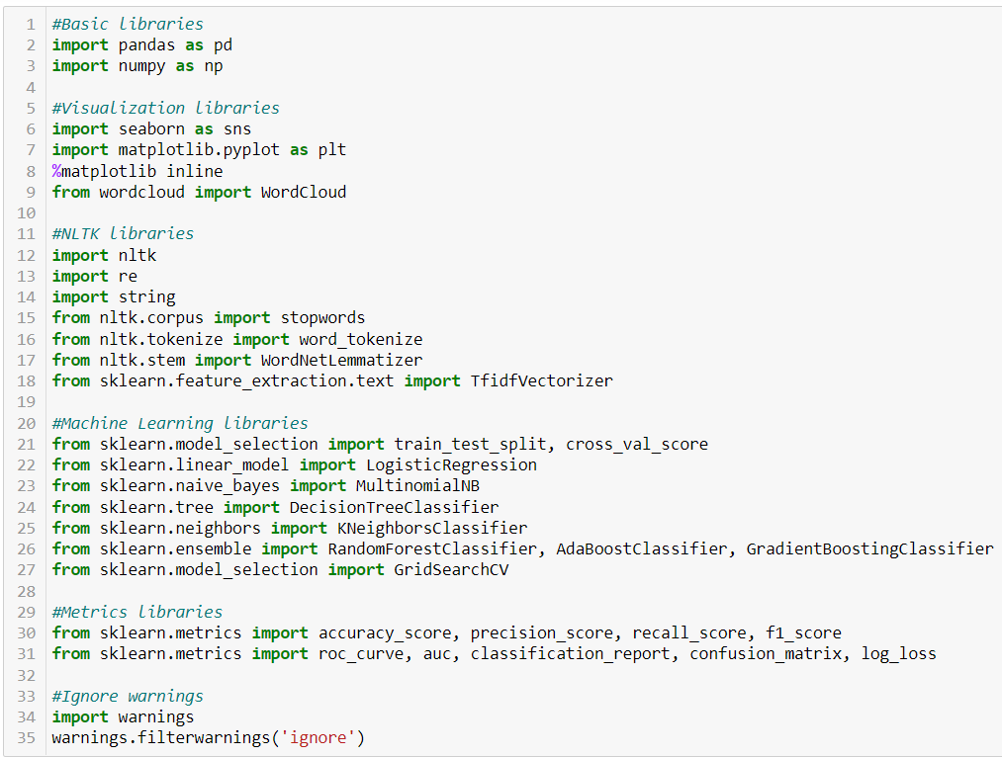
LIBRARIES USED

Slide 5
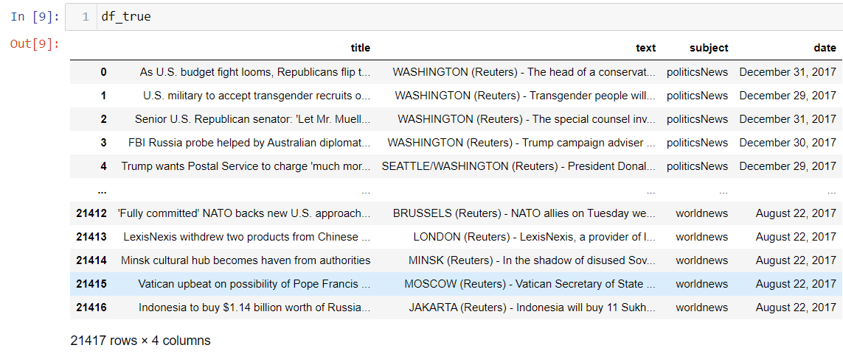
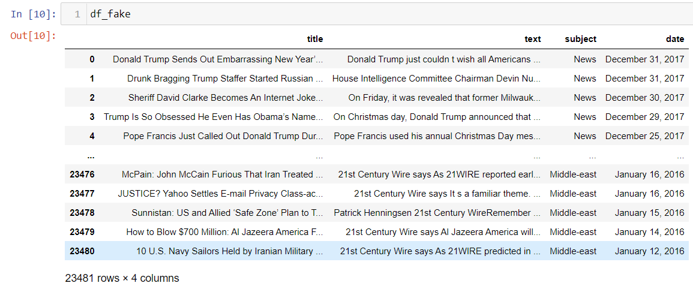
DATA SOURCES AND THEIR FORMATS
You can find many datasets for fake news detection on Kaggle or many other sites. I download these datasets from Kaggle. There are two datasets one for fake news and one for true news. In true news, there is 21417 news, and in fake news, there is 23481 news. You have to insert one label column zero for fake news and one for true news. We are combined both datasets using pandas built-in function.

Slide 6
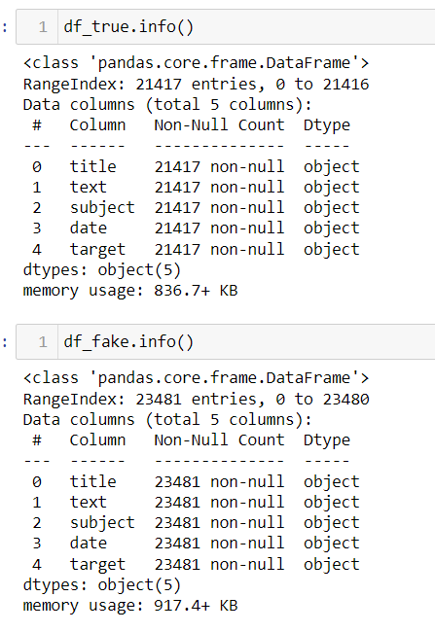
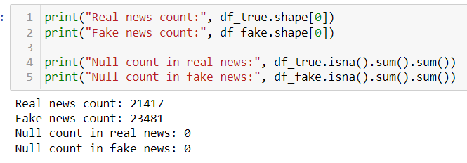
Exploring the Data separately

Slide 7
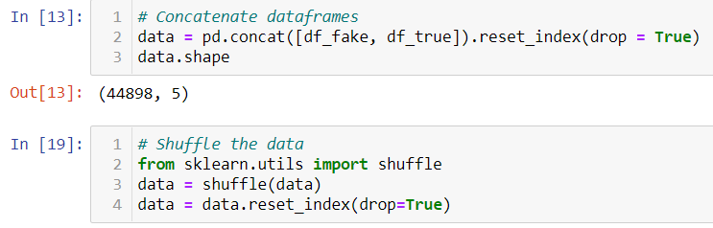
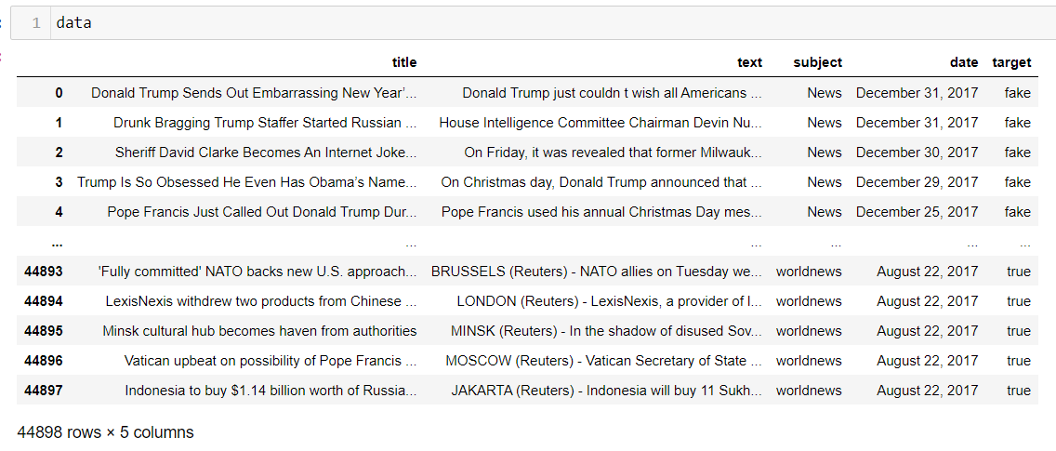
Combining the two Dataset
We concatenated the two data into one DataFrame so that we could easily do any EDA and preprocessing comfortably and will find the training the data will be easy as well.

Slide 8
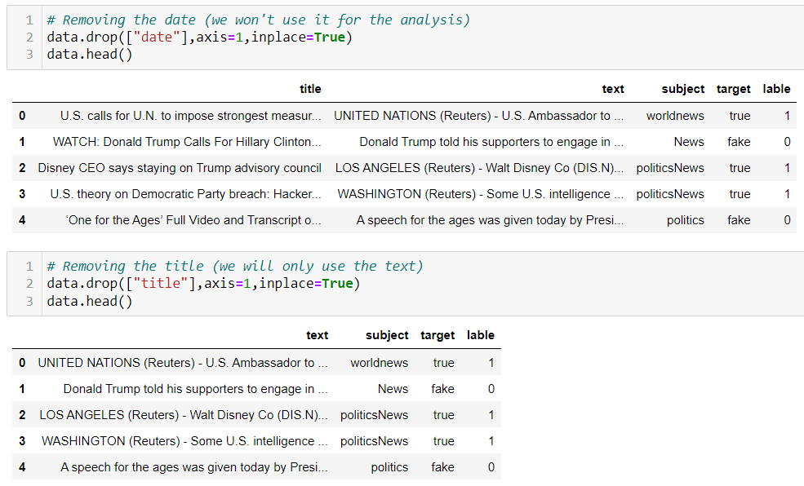
DATA PRE-PROCESSING
Dropping the DATE and TITLE column.
Removing the date (we won't use it for the analysis), also, Removing the title (we will only use the text).

Slide 9
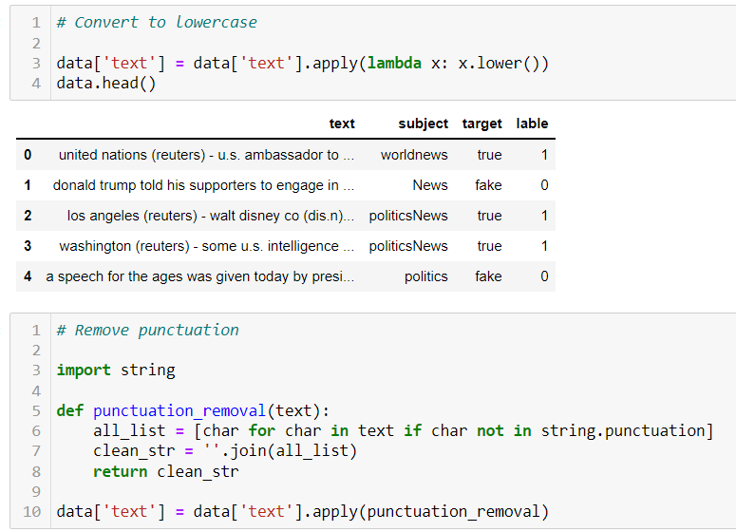
Convert to lowercase and Remove punctuation

Slide 10
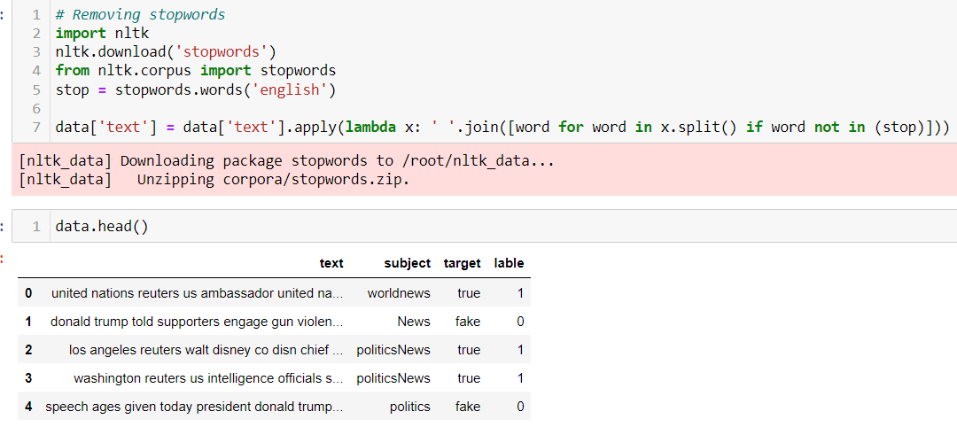
Removing Stop-Words

Slide 11
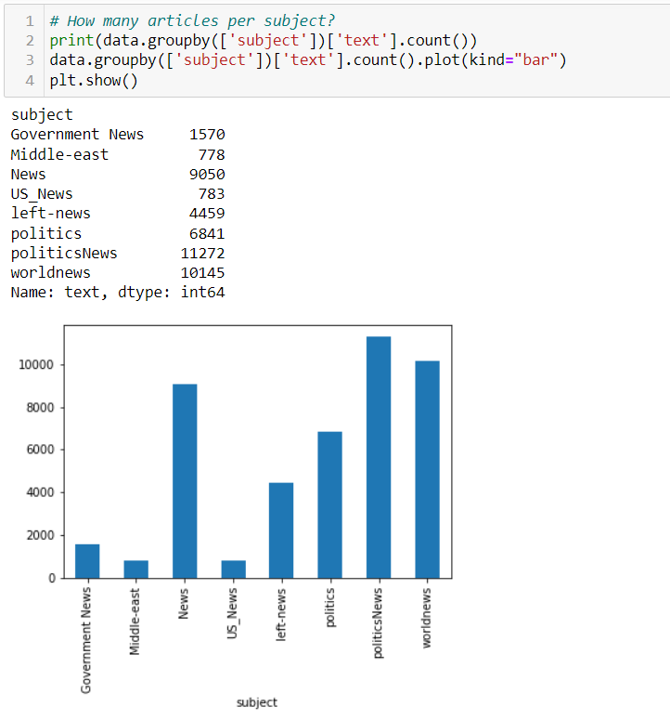
Exploratory Data Analysis
As we can see that the subject “PoliticalNews” are the most in the Dataset but the least subject in news are of “Middle-East” and “US_News”.

Slide 12
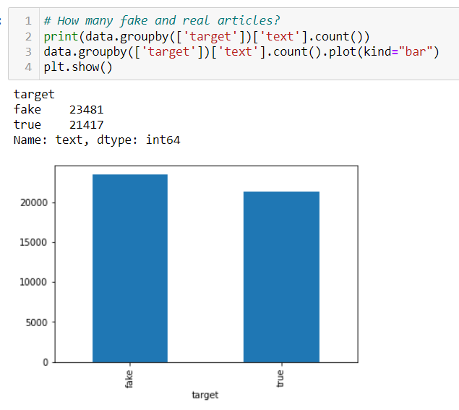
Exploratory Data Analysis
We can see that the data is balanced well, as equal weightage of 0's and 1's are given to the label column so that there is no need to handle the dataset by applying sampling techniques.

Slide 13
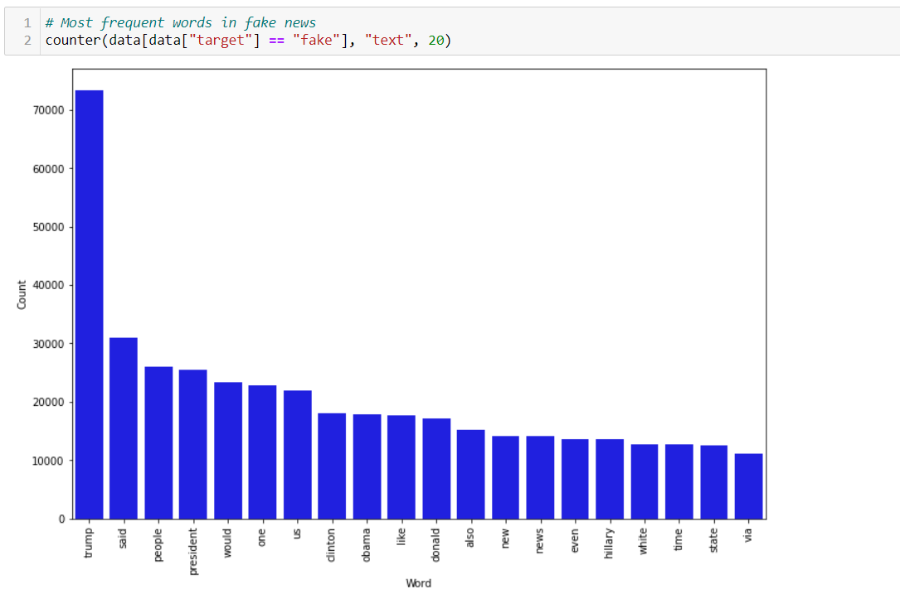
Exploratory Data Analysis
As we can say from the graph that most frequent words used in fake words and by quite large number is “Trump”.
And the least frequent words used is “via”.

Slide 14
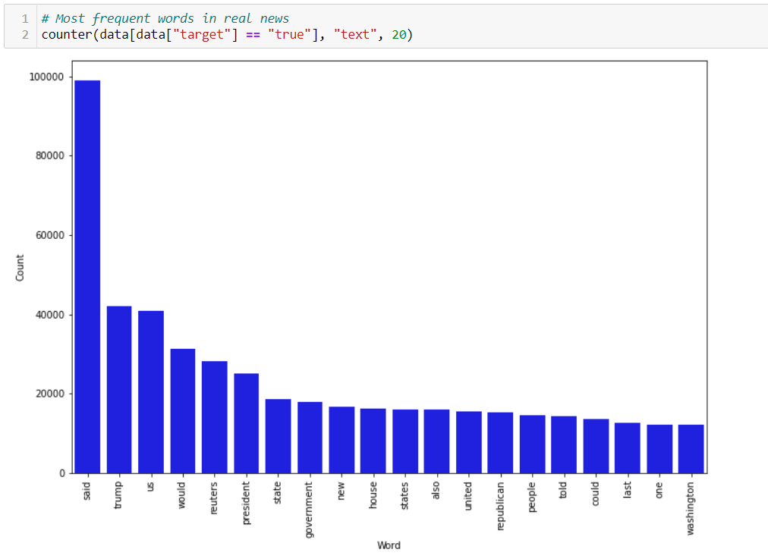
Exploratory Data Analysis
As we can say from the graph that most frequent words used in True words and by quite large number is “said”.
And the least frequent words used are “Washington” and “one”.

Slide 15
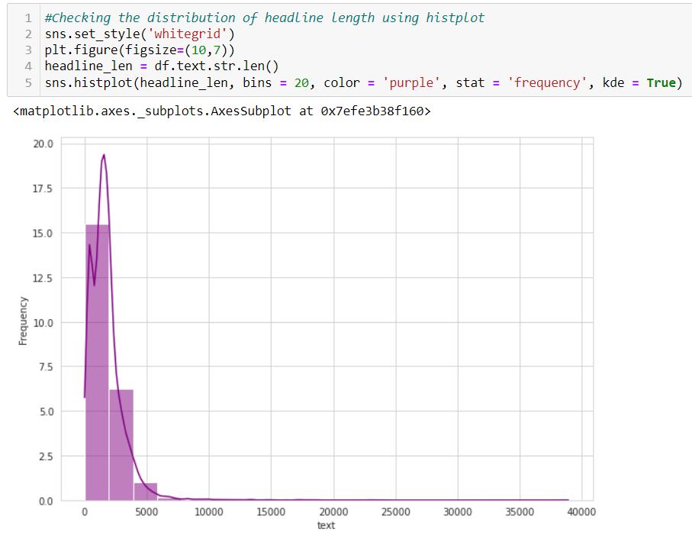
Exploratory Data Analysis
Majority of the news are of length below 1000, where maximum length is above 140000.

Slide 16
Preprocessing using NLP
Data cleaning is the process of preparing data for analysis by removing or modifying data that is incorrect, incomplete, irrelevant, duplicated, or improperly formatted. This data is usually not necessary or helpful when it comes to analysing data because it may hinder the process or provide inaccurate results.
Before cleaning the data, a new column is created named ‘length_before_cleaning’ which shows the total length of the news respectively before cleaning the text.
The following steps were taken in order to clean the text:
Transform the text into lower case.
Replaced the email addresses with the text 'emailaddress'
Replaced the URLs with the text 'webaddress'
Removed the HTML tags
Removed the numbers
Removed extra newlines
Removed the punctuations
Removed the unwanted white spaces
Removed the remaining tokens that are not alphabetic
Removed the stop words
We also created new features for comparing the original length before cleaning and the new length after cleaning.

Slide 17
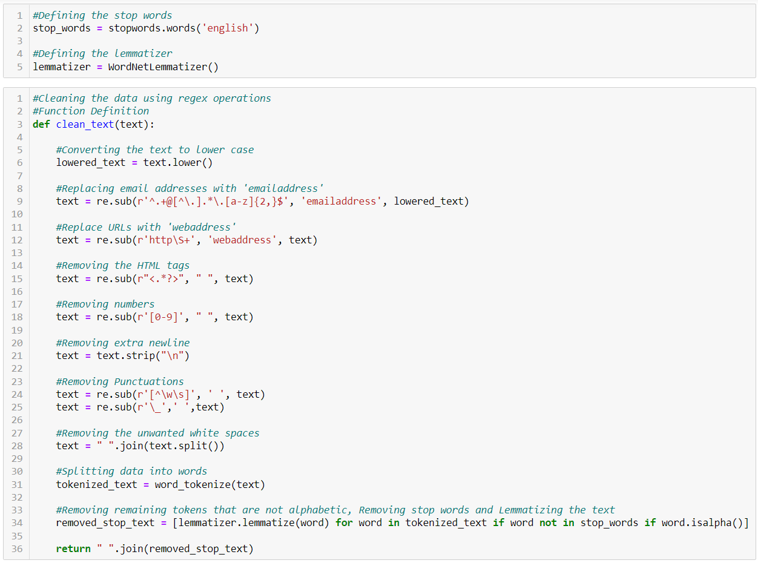
Preprocessing using NLP

Slide 18
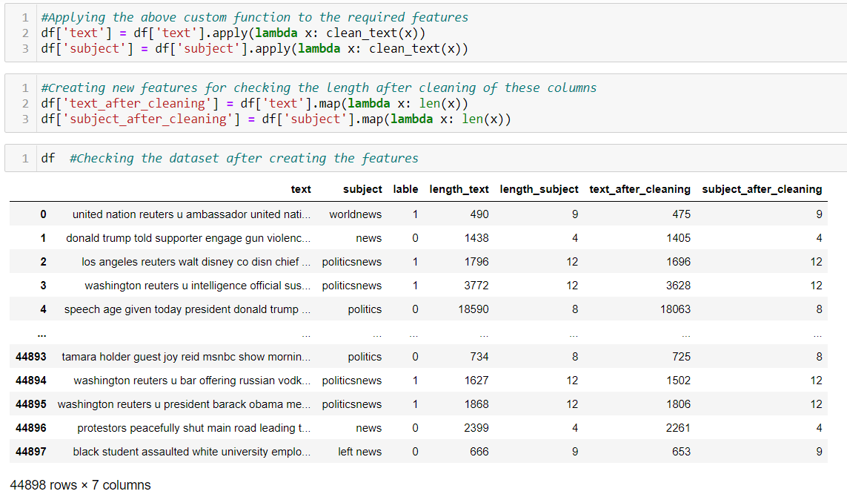
Preprocessing using NLP
We can see that the new length features are created and then added to the dataset. Now, we will calculate the total words removed in all the columns

Slide 19
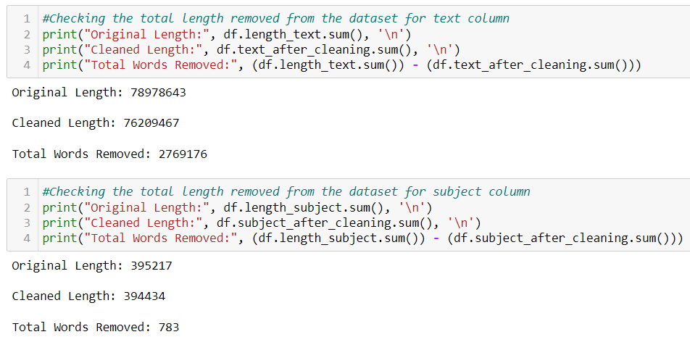
Preprocessing using NLP
We can observe that more number of unwanted words were removed from the dataset and it was done by using regex operations and other NLP techniques.

Slide 20
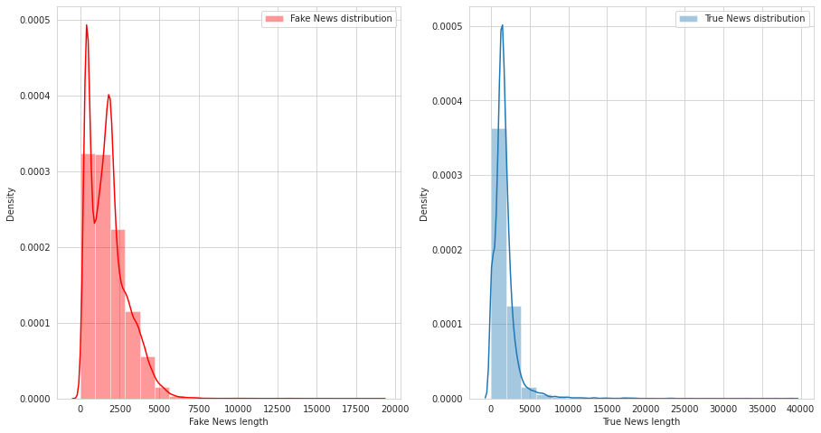
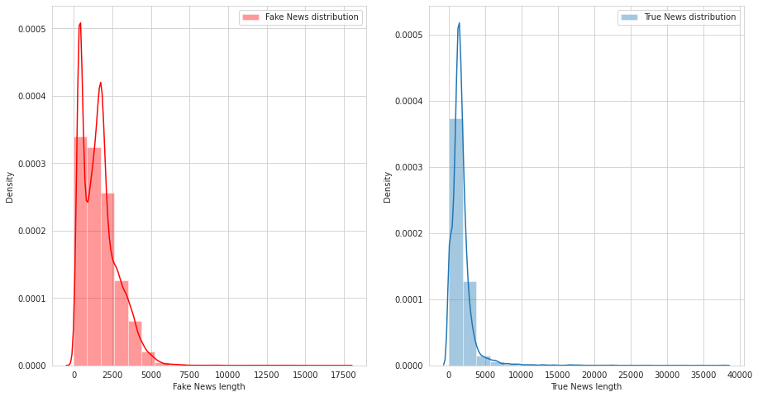
Plotting features before and after cleaning the data
Before cleaning
After cleaning

Slide 21
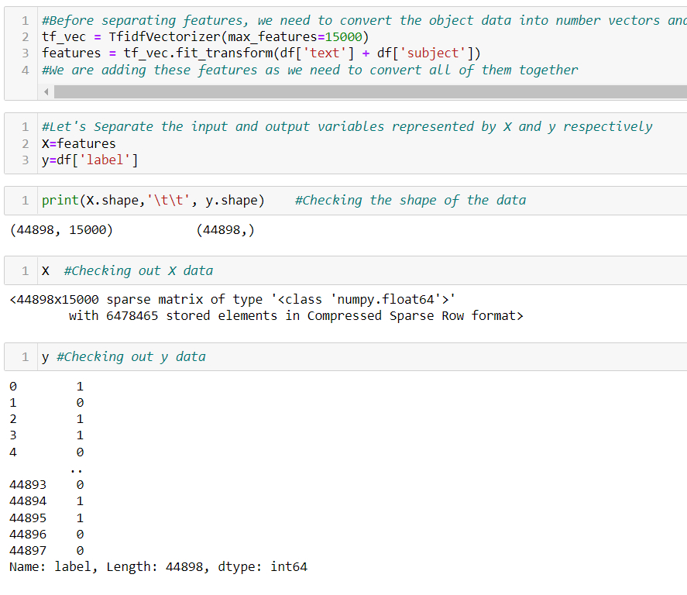
MODEL/S DEVELOPMENT AND EVALUATION
Separating the input and output variables and Vectorizing X feature

Slide 22
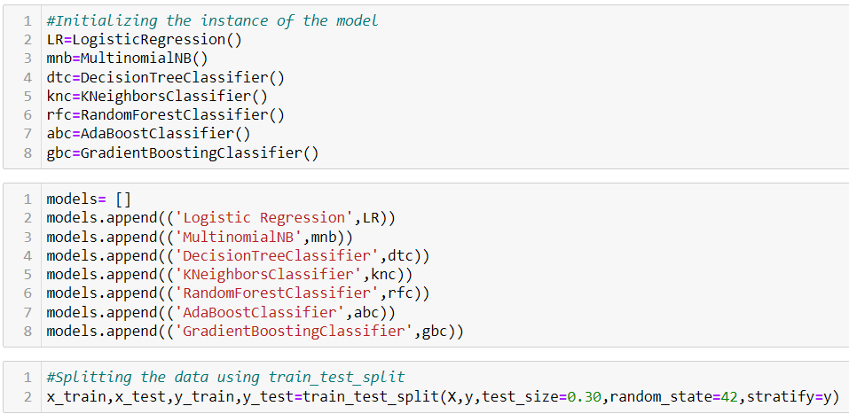
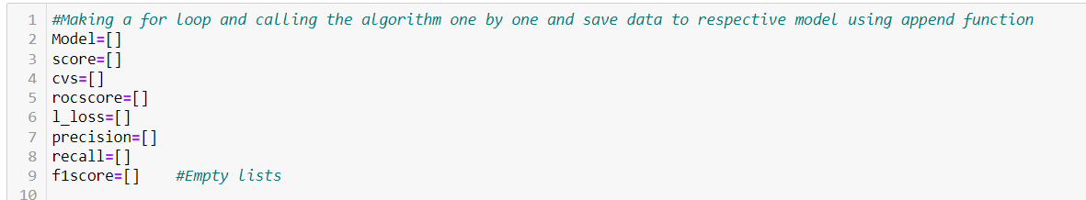
MODEL Building
Initializing the instance of the model.

Slide 23
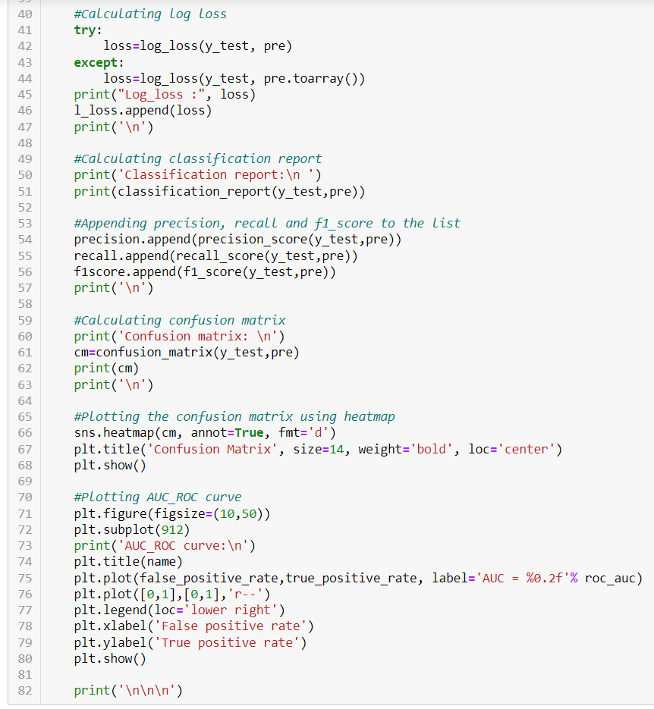
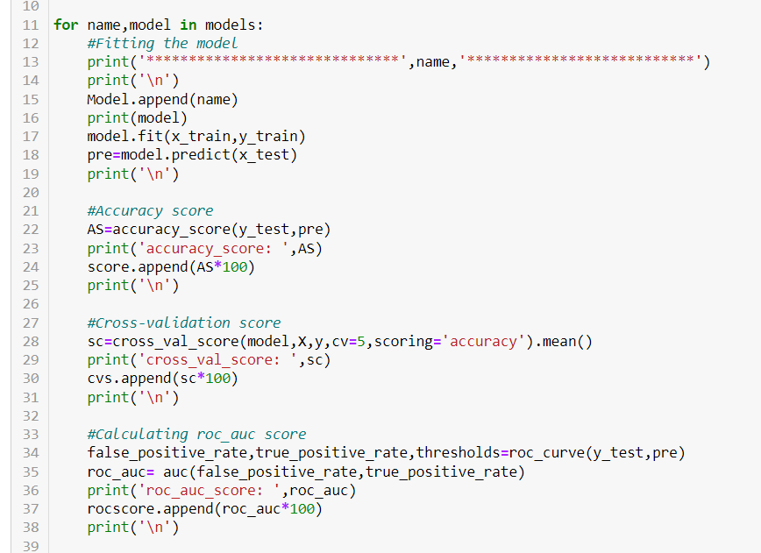
MODEL Building
Fitting the model.

Slide 24
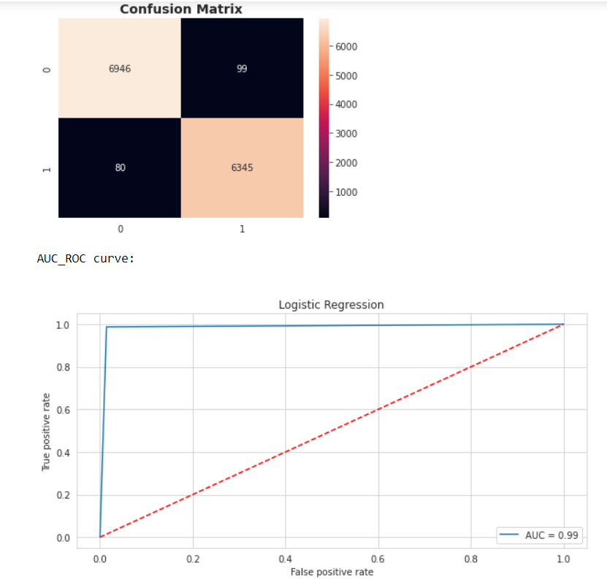
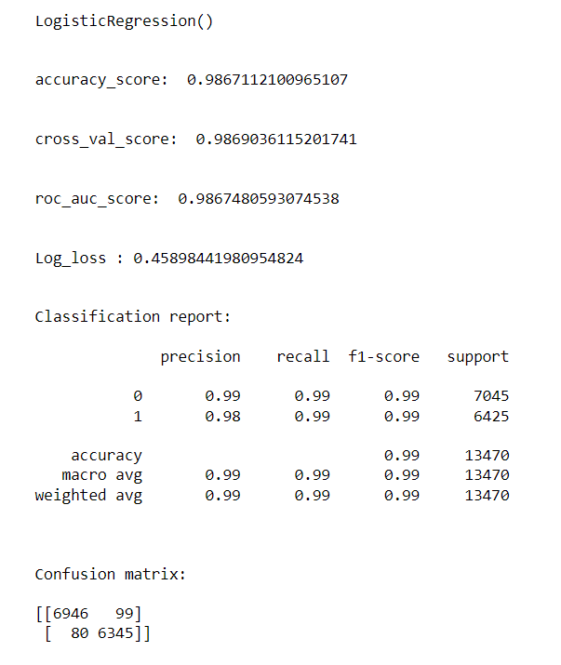
Viewing the output
Logistic Regression

Slide 25
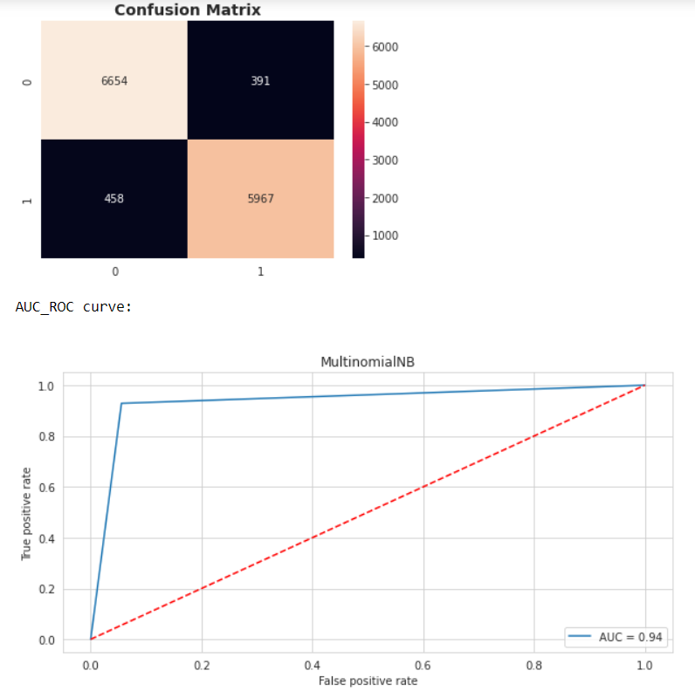
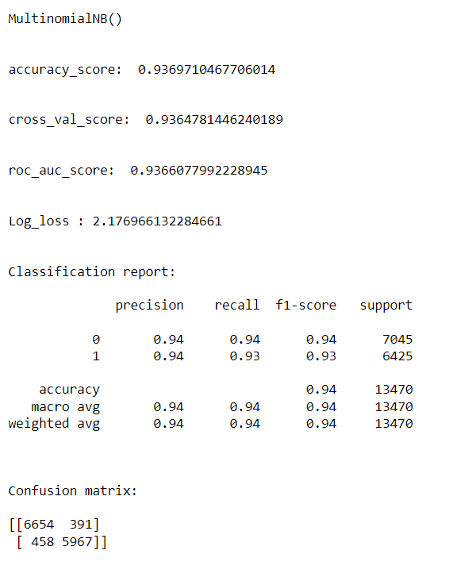
Viewing the output
MultinomialNB

Slide 26
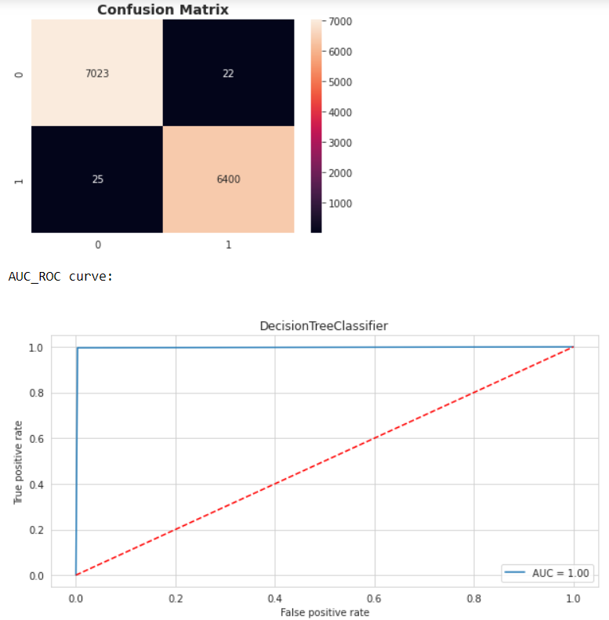
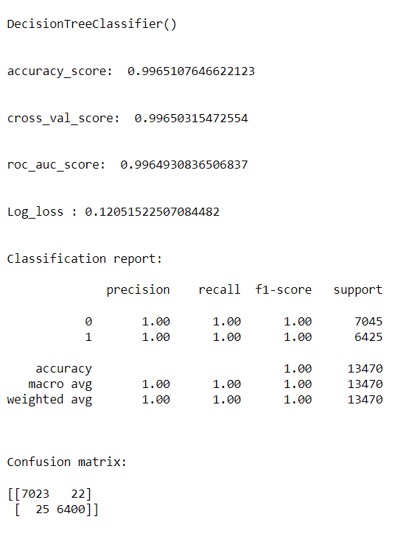
Viewing the output
DecisionTreeClassifier

Slide 27
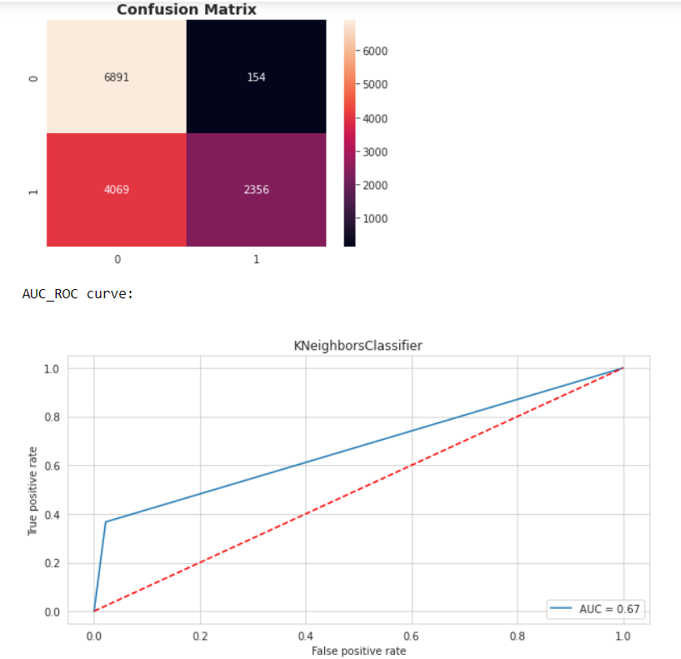
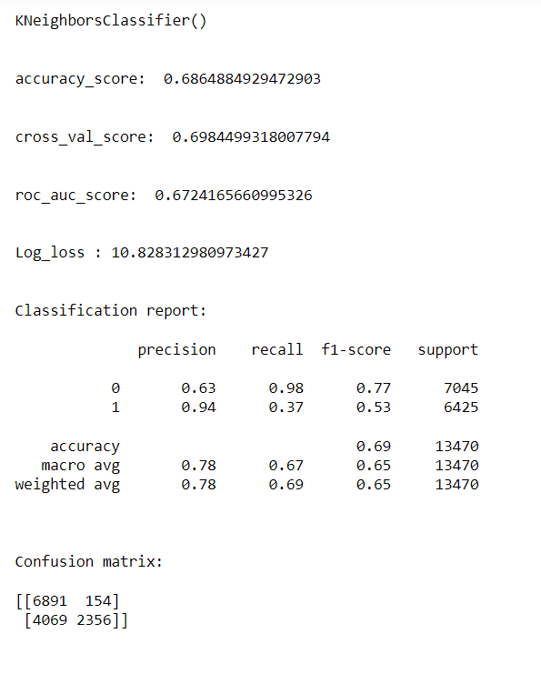
Viewing the output
KNeighborsClassifier

Slide 28

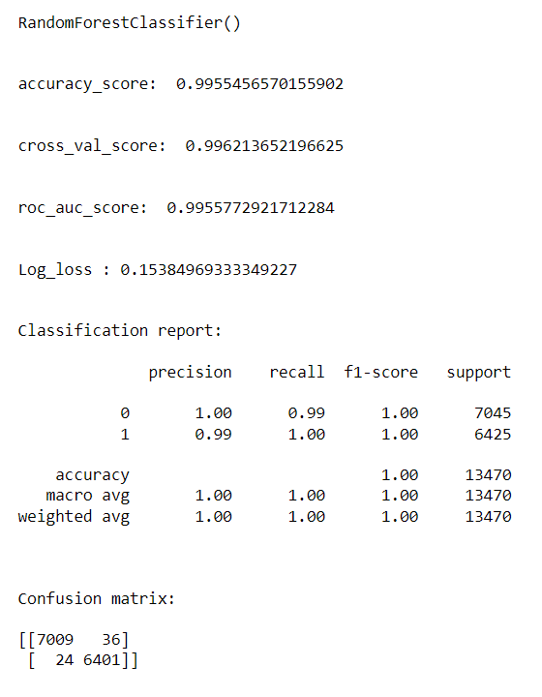
Viewing the output
RandomForestClassifier

Slide 29

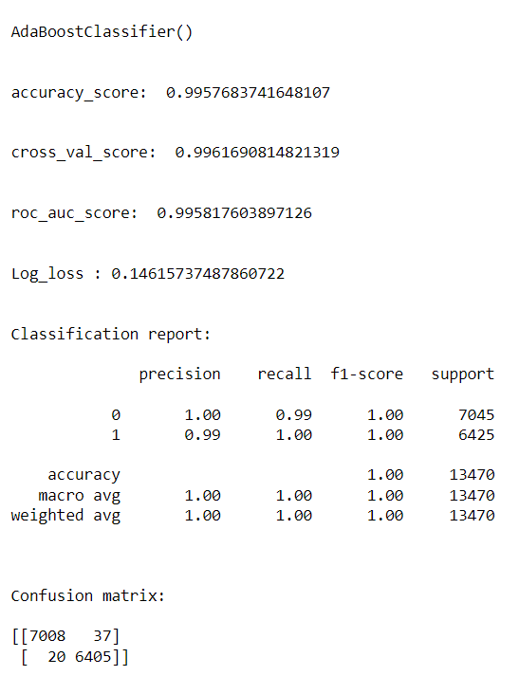
Viewing the output
AdaBoostClassifier

Slide 30

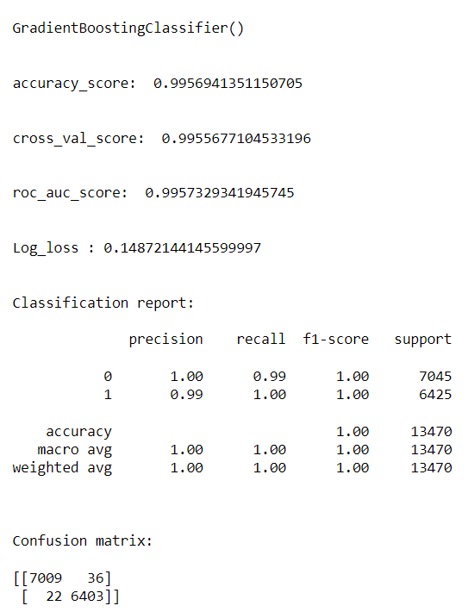
Viewing the output
GradientBoostingClassifier

Slide 31
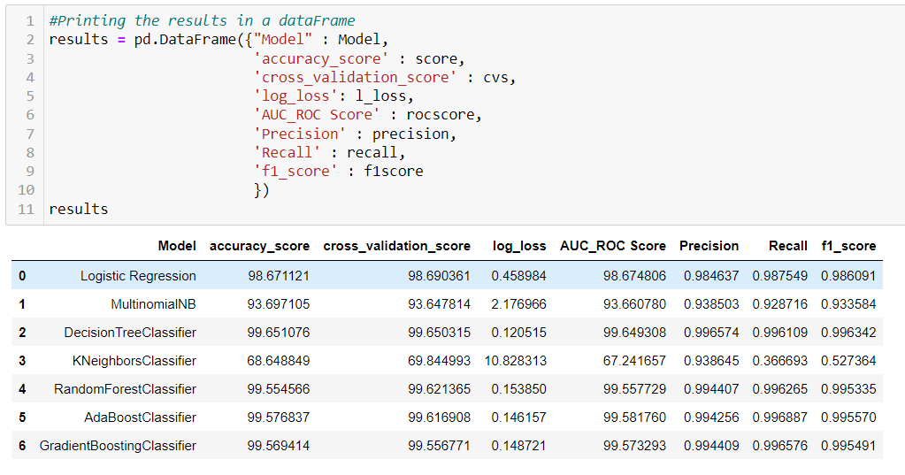
Splitting the train and test data
Training and testing the models minimize the effects of data discrepancies and better understand the characteristics of the model. The training data is used to make the machine recognize patterns in the data and the test data is used to see how well the machine can predict new answers based on its training. ‘X’ and ‘y’ were split for training and testing using train_test_split in a ratio of 70:30 respectively.
Building the model
After running various algorithms, the final results are as follows:

Slide 32
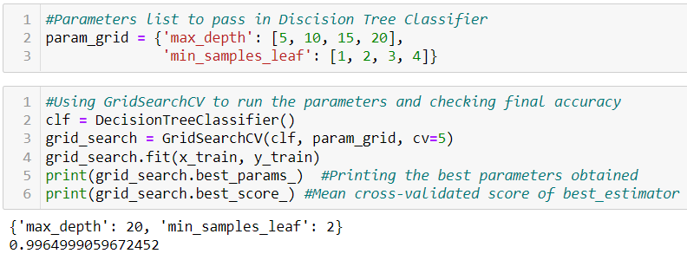
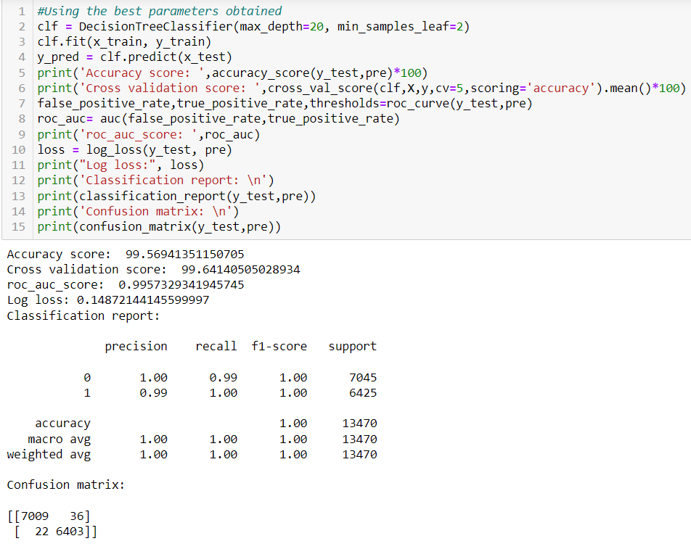
After running the algorithms and according to the scores of performance metrics and other scores, we can see that Decision Tree Classifier algorithms are performing well. Now, we will perform Hyperparameter Tuning to find out the best parameters and try to increase the scores .
Hyperparameter Tuning
After tuning the model, we got logistic regression as the best performing model and the code is given below:

Slide 33
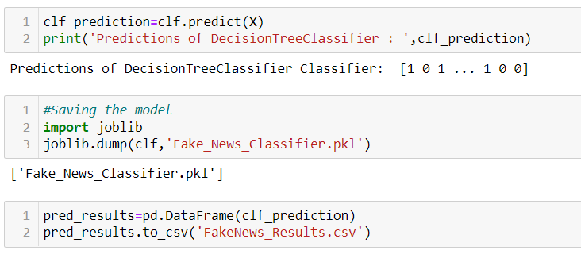
Finalizing the model
After predicting using test data, we will store the results in a csv file.

Slide 34
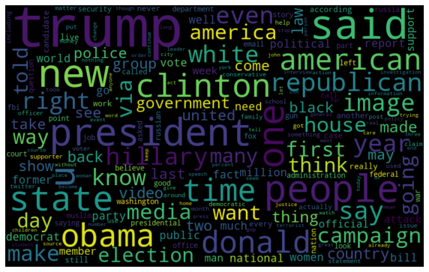
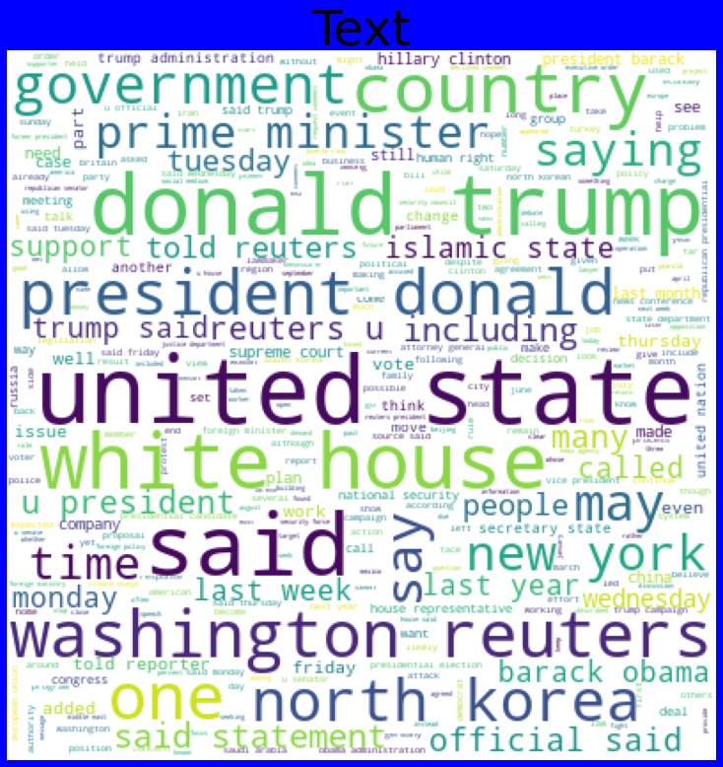
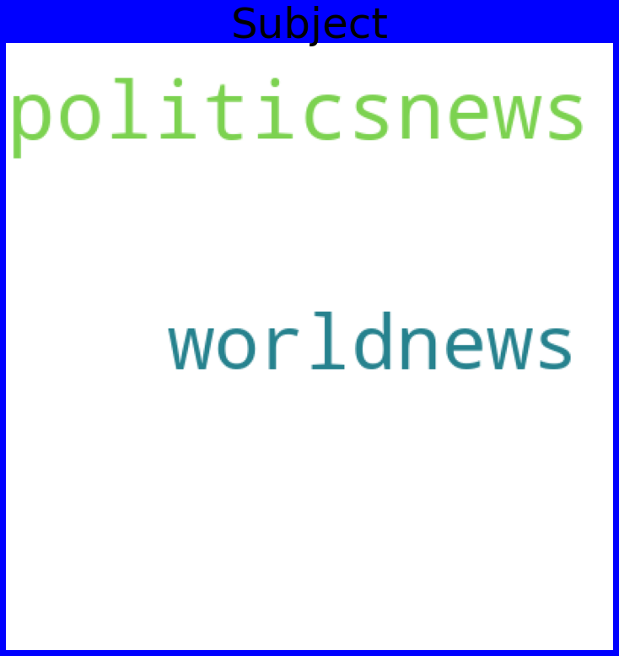
Plotting wordcloud
For fake data:

Slide 35
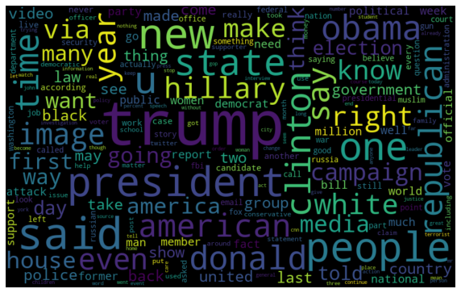
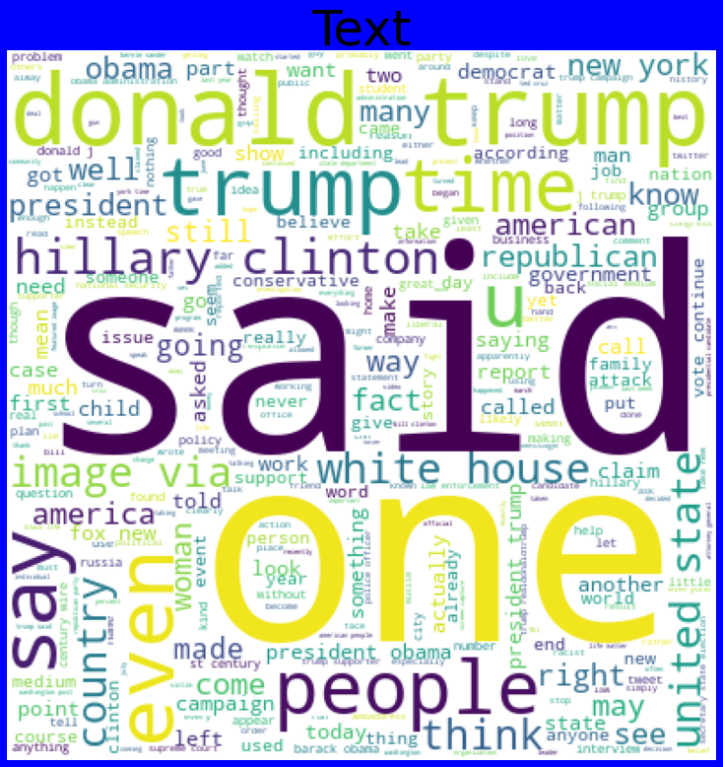
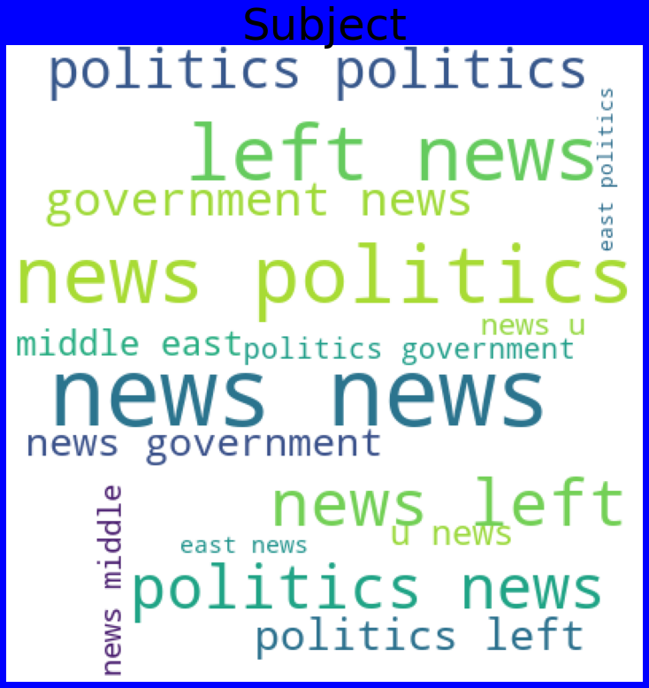
For True data:

Slide 36
CONCLUSION
After the completion of this project, we got an insight of how to preprocess the data, analyzing the data and building a model.
First, we imported the 2 datasets True.csv and Fake.csv which had more than 20000 records each.
We did all the required pre-processing steps like checking null values, datatypes check, dropping unnecessary columns, etc.
We did the Exploratory Data Analysis using various plots and recorded the observations.
Using NLP, we pre-processed the comment text and did other steps like: -Removing Punctuations and other special characters -Splitting the comments into individual words -Removing Stop Words -Stemming and Lemmatising -Applying Count Vectoriser -Plotting wordcloud for knowing the weightage of words used
We created many new features like length of words before pre-processing and after pre-processing inorder to know the words cleaned after the necessary steps.

Slide 37
We applied Tf-idf Vectorizer for scaling the data into number vectors and for x feature we combined the written_by, news and headlines together.
Then, we split the data using train_test_split and then we started the model building process by running as many algorithms in a for loop, with difference metrics like cross_val_score, confusion matrix, auc_score, log loss, precision, recall, f1_score, etc.
We found that Decision Tree Classifier was performing well. The next step was to perform hyperparameter tuning technique to these models for finding out the best parameters and trying to improve our scores.
We finalized the model by predicting the outputs, saving the model and storing the results in a csv file.
Problems faced while working in this project:
1- More computational power was required.
2-More missing data were present in the dataset.
3-Loss was more for some algorithms.

Slide 38


